Slide 1
CorryptoCurrency
Team 3
Hyunseo Park
Kyuyong Kim
Eonseon Park
Junseok Jeon

Slide 2




Background
Cryptocurrency market has been growing rapidly in recent years
Investing in cryptocurrency has become a trend
Hard to predict the price of cryptocurrency
Certainty and stability required
Notes:
For this reason, cryptocurrency market has been growing rapidly in recent years. many people invest in cryptocurrency and it become a trend. But predicting the price of cryptocurrency is difficult. Because it’s very volatile. So investor need certainty and stability.

Slide 3
Background
Real-time data from cryptocurrency market
Money making solution
Data analysis
Notes:
People want profit, but it hard. Data analysis with real time data from cryptocurrency market will be money making solution.

Slide 4


Cryptocurrency

Slide 5






Pipeline
Web
Backend
Data 처리
및 분석
Data
저장
Data
Notes:
Here is data pipeline. we use api, kafka spark streaming , Hadoop, apache spark to provide our service.

Slide 6



Data Pipeline
Data Pipeline
Data Processing
Data Processing
Data Ingestion
Data Ingestion
With Spark, the LSTM model couldn’t be implemented to predict price, instead we used jupyter notebook
Kafka is system for distributed processing while it is not necessary in our service

Slide 7

Cryptocurrency
DATABASE

Slide 8
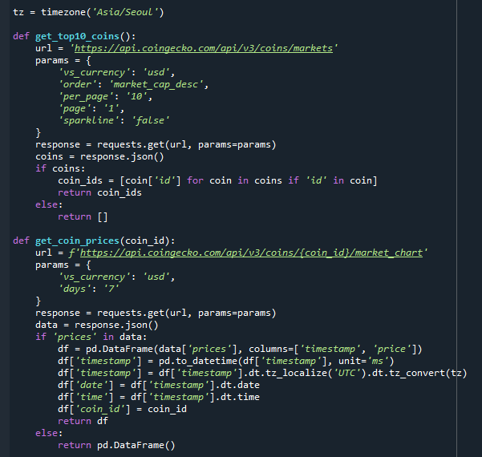
B
IG DATA
Collection
Using CoinGecko API to collect the top10 coins price data.
Get 7 days data from CoinGecko API.

Slide 9
B
IG DATA
Processing
Transforms raw data into a format suitable for analysis and decision-making.

Slide 10
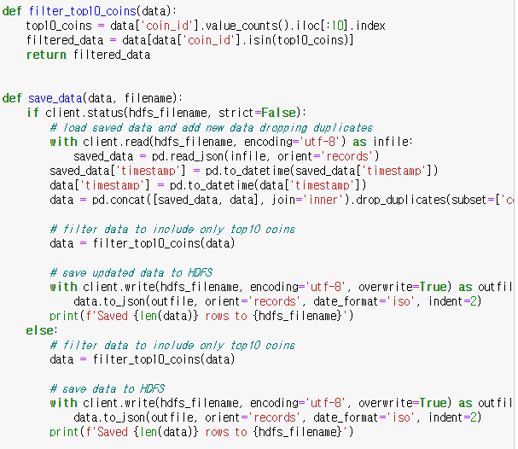
B
IG DATA
Processing
Save data at HDFS if its first implement.
After first implement, check duplicate and changes about saved data in HDFS delete duplicates and append new data at data.json.

Slide 11
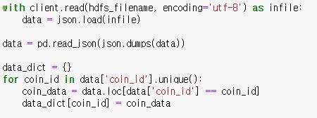
B
IG DATA
Storage
Bring data from HDFS and make dictionary.

Slide 12
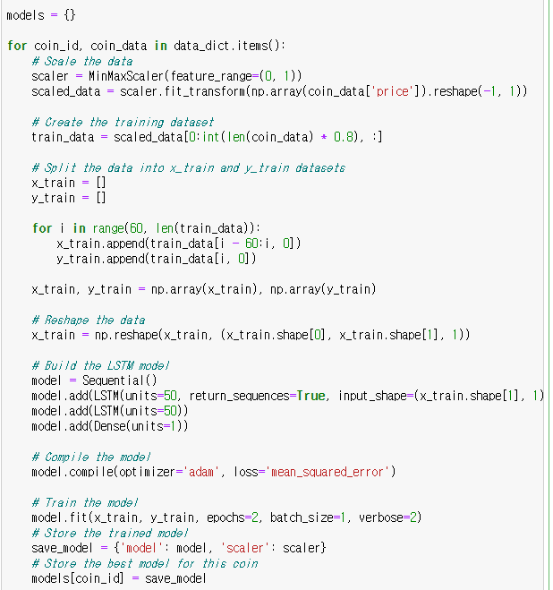
B
IG DATA
Analysis
Split the data to train data set.
Train LSTM model for predict the coin price.
Save model for each coins.

Slide 13
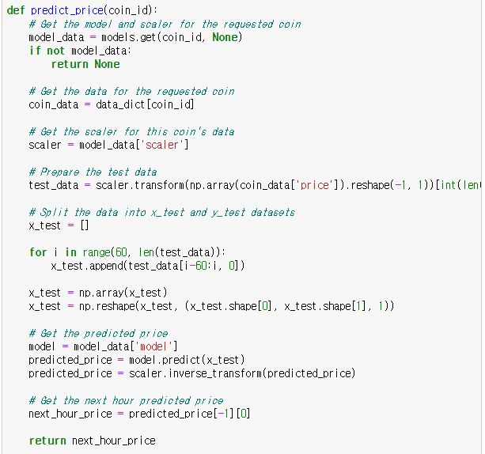
B
IG DATA
Analysis
Split data to test data set.
Using saved LSTM model to predict the price for each coin.

Slide 14
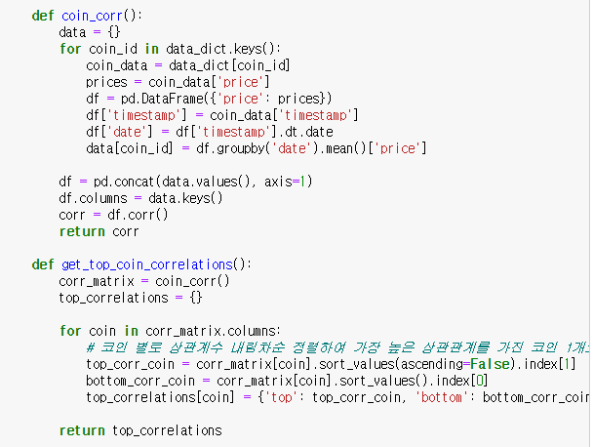
B
IG DATA
Collection
Calculate correlations of coins to get the most and least correlated coin for each coins.

Slide 15
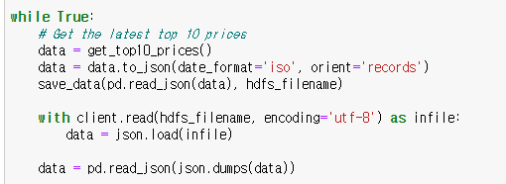
B
IG DATA
Streaming
Use infinity loop to update the coin price data for every 1 hour.

Slide 16
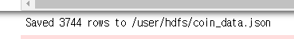
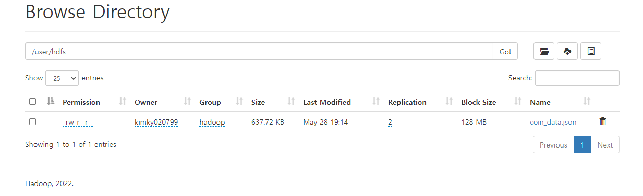
B
IG DATA
Streaming
Show new data which append to the before data set.
Show coin_data.json is stored in HDFS.

Slide 17
Cryptocurrency
WEB

Slide 18
Web
data
By using the google cloud API generated, we could access the data files.

Slide 19
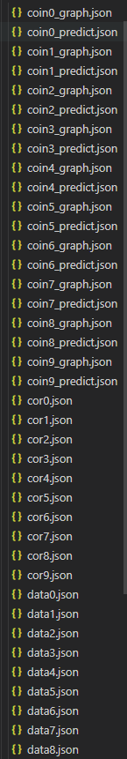
Web
Json data
4 types of json data files
Coins’ price data
Coins’ predicted price data (past)
Highest & Lowest correlated coin
4) Predicted price data after 1 hour (future)

Slide 20
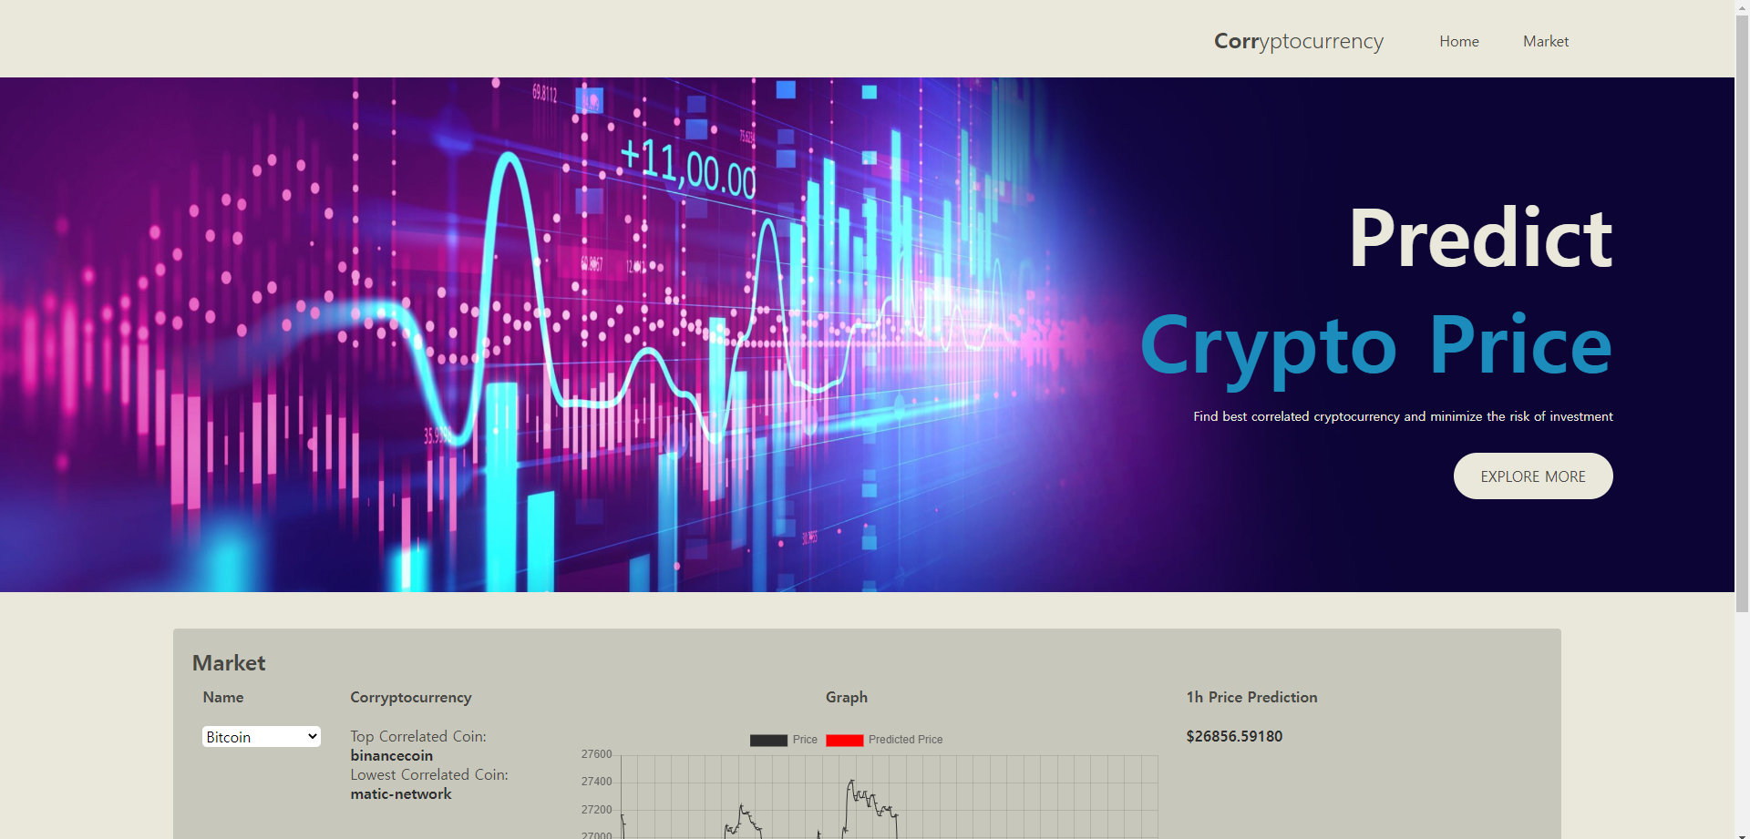
Web
Overall Website

Slide 21
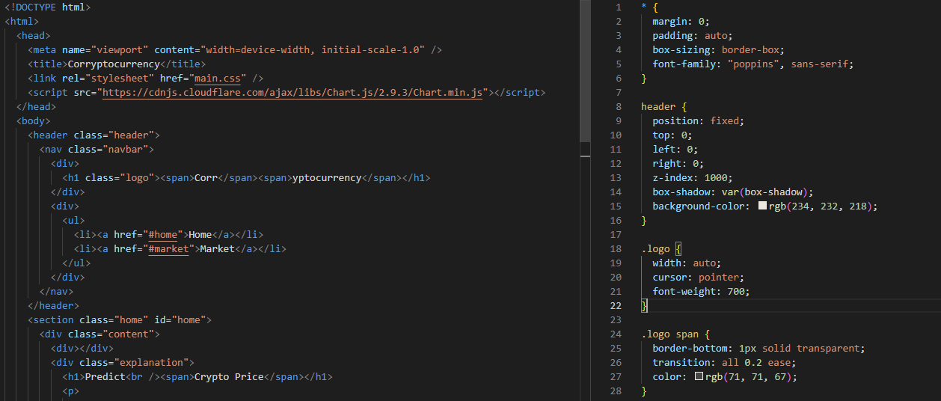
Web
main.html main.css

Slide 22
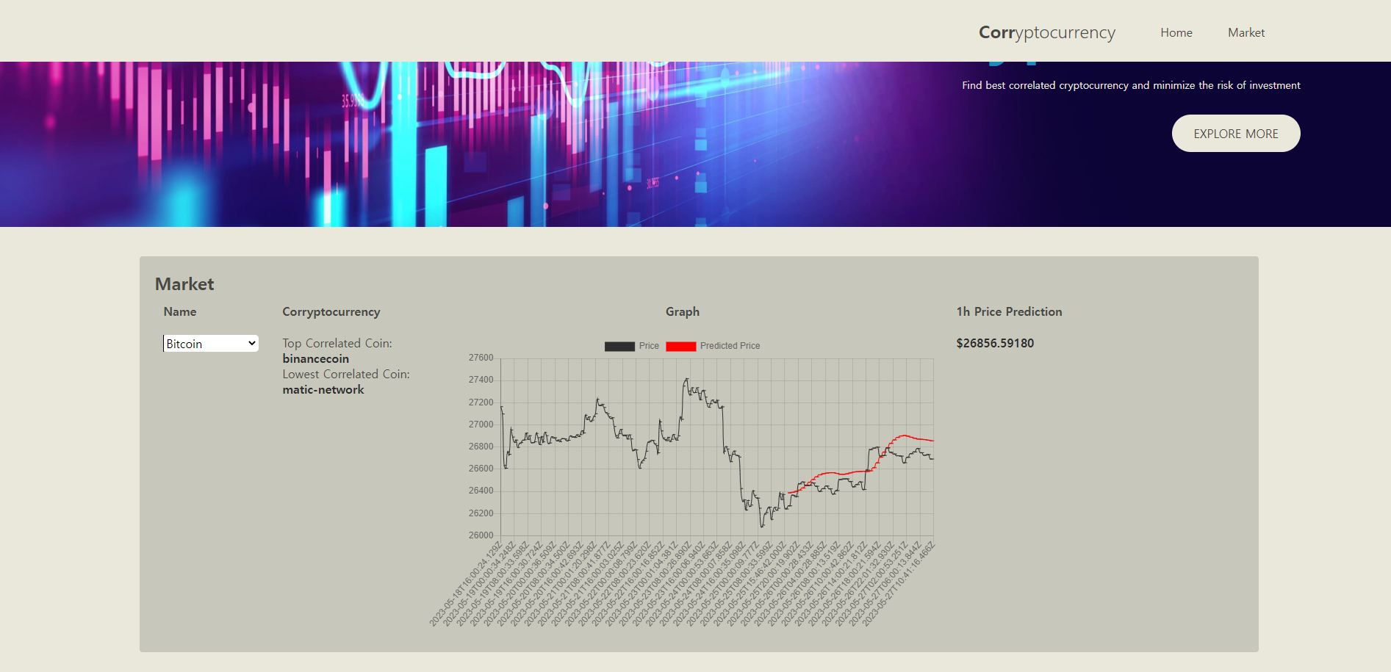
Web
Click Market or Scroll down

Slide 23
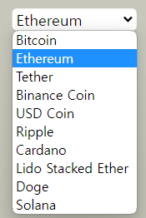
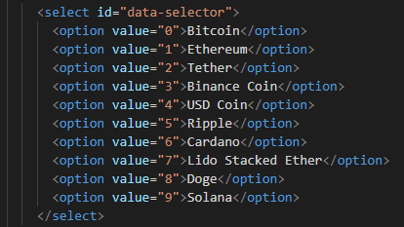
Web
Streaming
Drop Down Menu- Select one of 10 cryptocurrncies

Slide 24
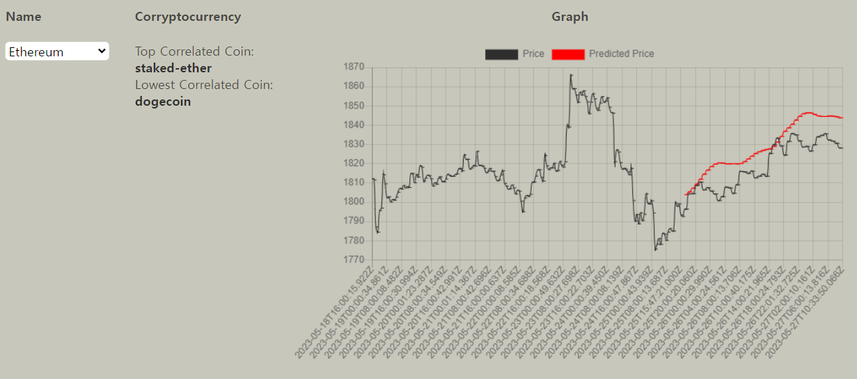
Web
graph
Black line – actual price data
Red line – predicted data(LSTM)

Slide 25
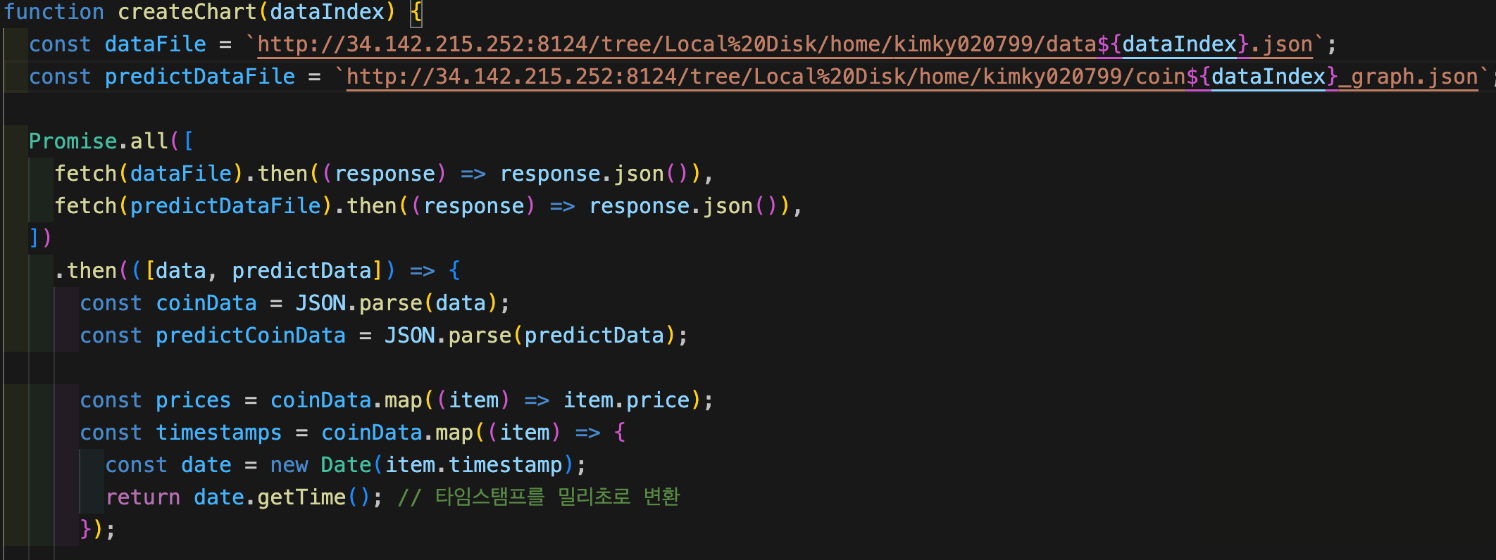
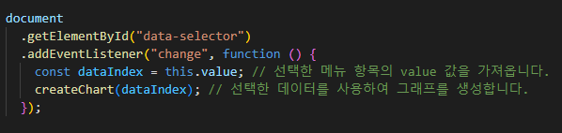
Web
graph
createchart.js
Function to create graph based on data
(actual price & predicted price)
Event listener to detect changes in the drop-down menu using JavaScript code

Slide 26
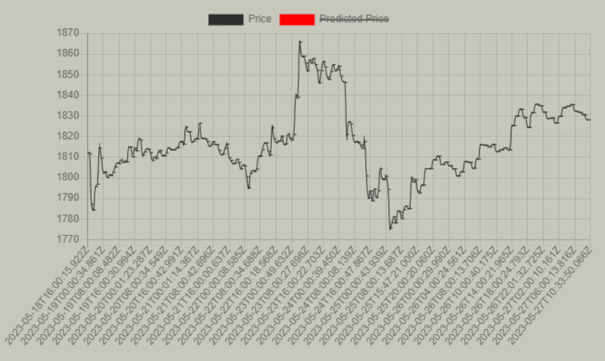
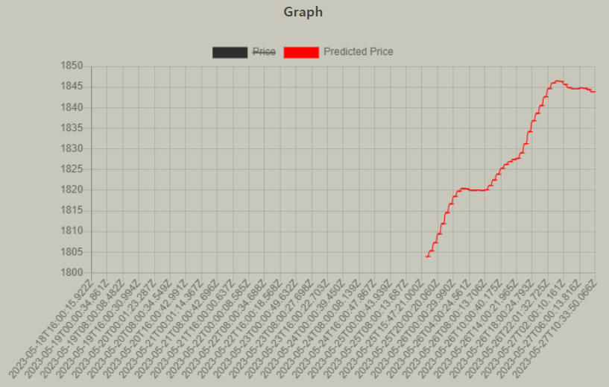
Web
graph
Available to see only one of price lines

Slide 27
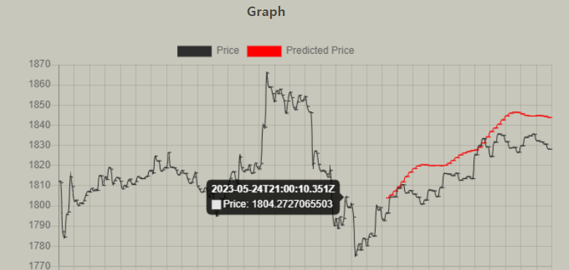
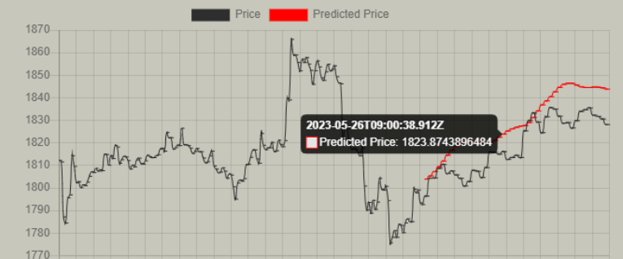
Web
graph
Available to see specific data when pointer is on the line

Slide 28
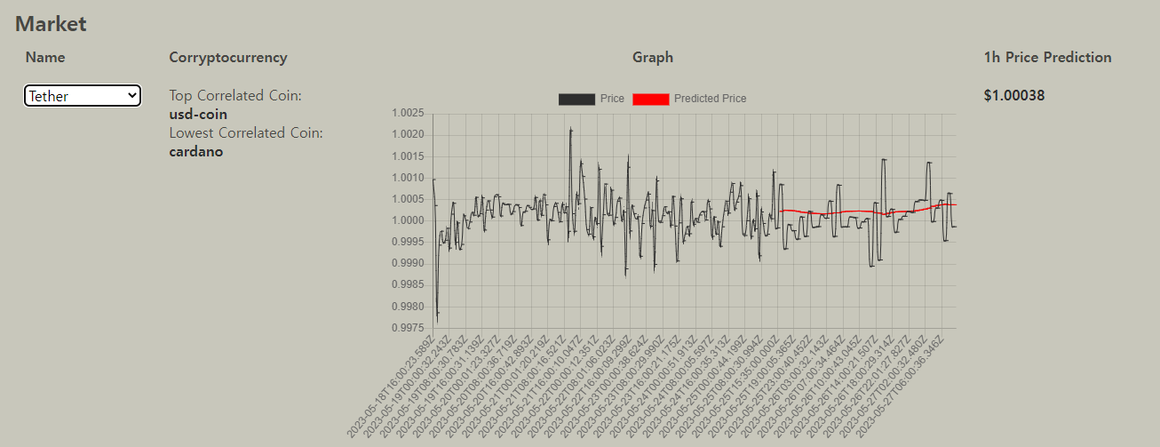
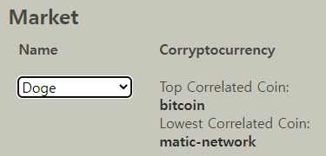
Web
Correlation
Based on specific coin, it figures out
highest correlated coin and lowest correlated coin
Data in cor2.json (Tether)

Slide 29
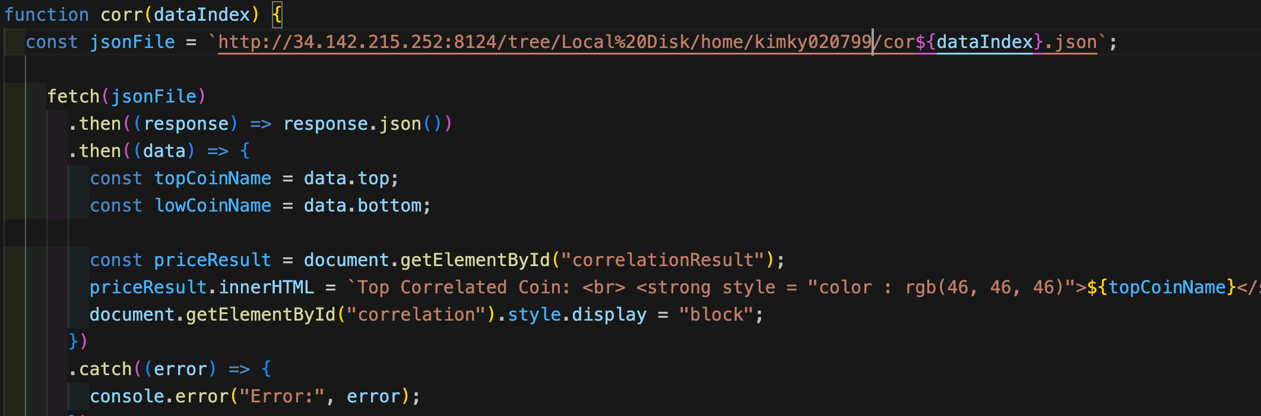
Web
Correlation
fetch(jsonFile): Fetch json files which include correlation information
Load data dynamically and display on web pages based on your selection

Slide 30
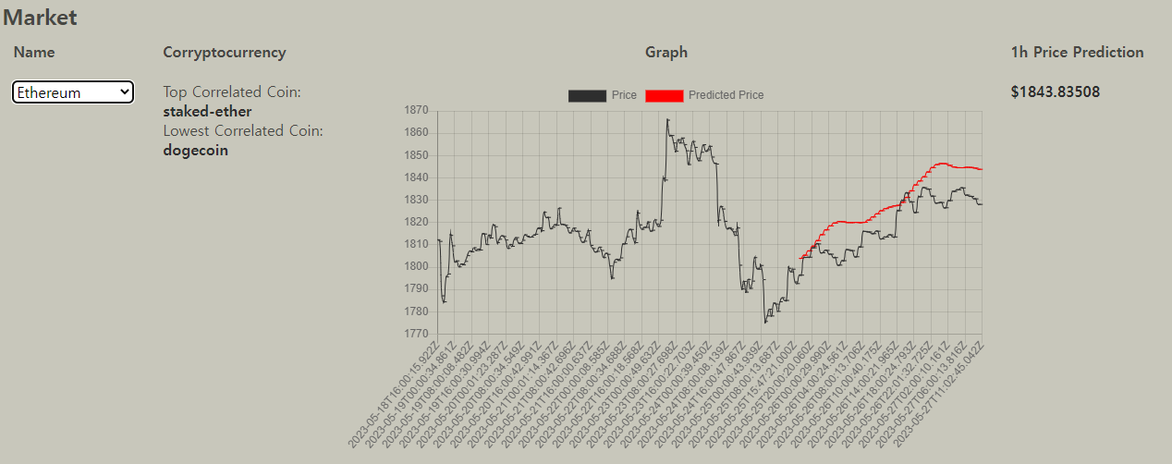
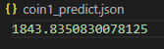
Web
Price after 1 hour
Right side of graph -> 1h Price Prediction indicates
how the price of the coin will come out in an hour

Slide 31
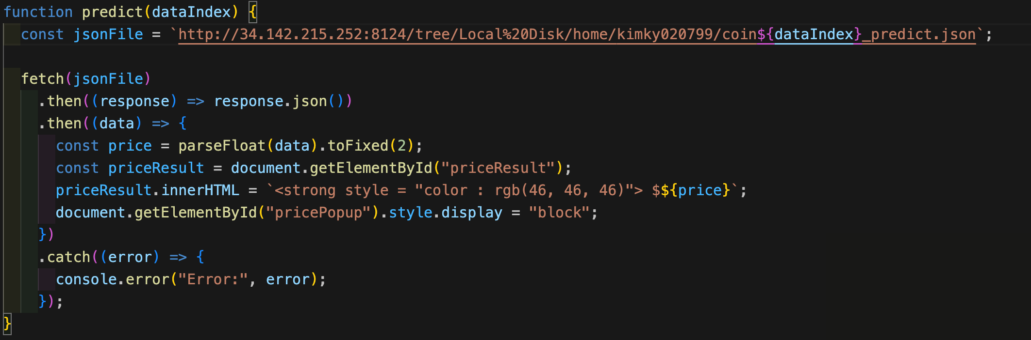
Web
Price after 1 hour
predict.js
The extracted price information is displayed up to 5 decimal places.

Slide 32
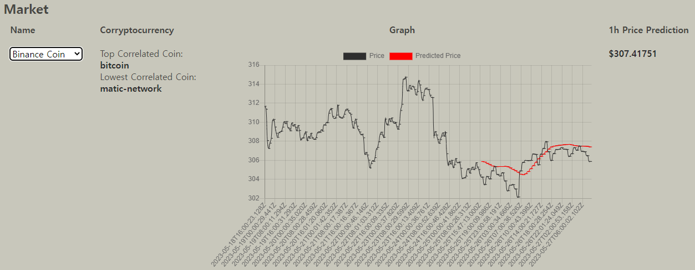
Web
Web allows for updating and changing three kinds of information simultaneously & synchronously on an HTML page using a single dropdown menu.

Slide 33

Cryptocurrency
CONCLUSION

Slide 34
Limitation
Predict price accuracy is low because LSTM epoch value is 2. If we increase epoch, need more time to train.
Using a dataframe for data preprocessing resulted in slower performance.
The slow performance is due to the inability to distribute the processing.

Slide 35
THANK YOU

